Slide 1
Predicting Zodiac Signs on OKCupid
A Data Analysis Presentation

Slide 2
Introduction

Slide 3
Goals
The goal of this project is to analyze data from OKCupid, a dating app that matches users based on multiple-choice and short-answer questions, with a focus on predicting users' zodiac signs.

Slide 4
Data
The data for this project is sourced from OKCupid and consists of various user attributes and profile responses. The dataset includes information about users age, body type, diet, drinking and smoking habits, education, essays, ethnicity, height, income, job, location, pets, religion, sex, sign (zodiac), and more. The data is structured as a tabular dataset, and its columns are a mix of categorical and numerical features.

Slide 5
Analysis
Data Cleaning: Address missing values in the dataset to ensure data quality.
Feature Engineering: Create new features or extract relevant information from existing ones that might enhance the predictive models.
Model Selection: Explore various machine learning models, including decision trees, logistic regression, support vector machines, and ensemble methods like random forests or gradient boosting.

Slide 6
Data Preprocessing
Feature Selection:
The essays may contain free-text responses, which are challenging to convert into structured data for zodiac sign prediction. Dropping these columns will simplify the dataset while retaining other potentially relevant features for analysis.
Data Manipulation:
Data manipulation is carried out in several columns to reduce diversity in the data. Some of these columns include: Body Type, Diet, Drinks, Drugs, Education, Ethnicity, Job, Location, Offspring, Pets, Religion, Sign, Smokes, Speaks, Status.

Slide 7
Data Preprocessing
Handling Missing Values:
There are various missing values in the data, so rows that have missing values are deleted. The deletion technique is used because this technique is the fastest compared to other techniques.
PyCaret Setup:
Create a setup in pycaret so that the data can be used for machine learning modeling

Slide 8
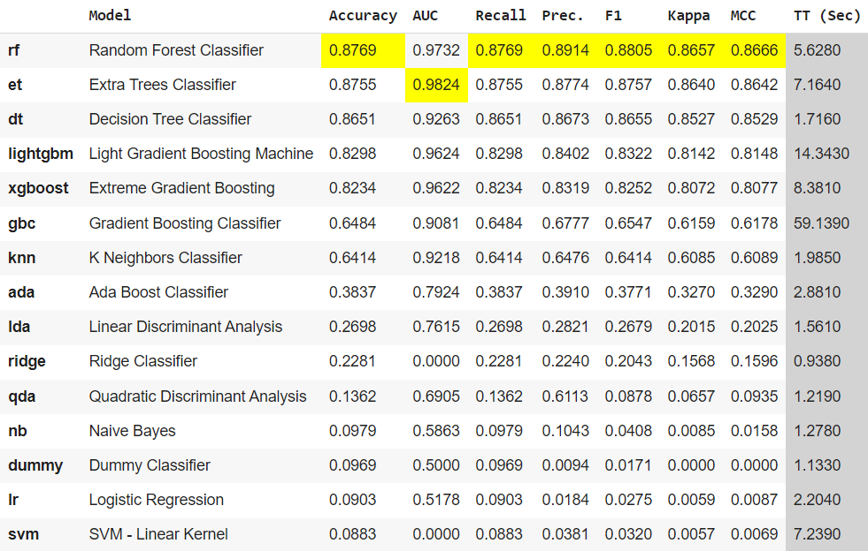
Model Learning & Model Evaluation
From the results it can be concluded that the Random Forest Classifier model has better metrics than other models.

Slide 9
Conclusion
The choice of the classification model should be based on the specific requirements of the application, considering factors such as accuracy, computational efficiency, and ease of interpretation. For predicting user behavior, Random Forest and Extra Trees classifiers offer strong performance, while Decision Tree Classifier provides a quicker alternative without a significant sacrifice in accuracy. Further optimization and feature engineering may improve the overall predictive power of these models.

Slide 10

Thankyou

